Slide 1
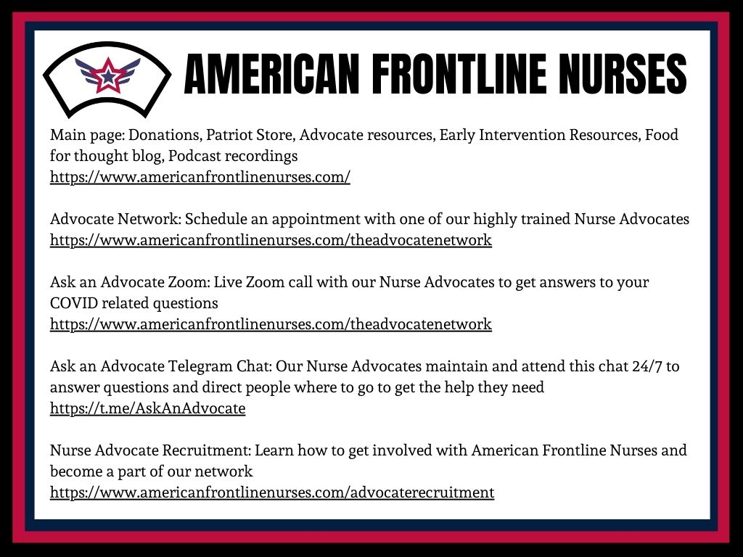
Coming Soon! 24 Hour Nurse Hotline
Main page with donations
https://www.americanfrontlinenurses.com/
Our main page for resources, on the top tab you can find our early intervention tab with resources needed to prepare for illness and get help with advocacy
Advocate Network
https://www.americanfrontlinenurses.com/theadvocatenetwork
A list of high educated and trained nurse advocates to help you and your family navigate health care
Ask an Advocate Zoom
https://www.americanfrontlinenurses.com/theadvocatenetwork
live zoom filled with nurse advocates to answer your questions and help get you connected to resources
Ask an Advocate Telegram Chat
https://t.me/AskAnAdvocate
A secure chat filled with nurse and family advocates to help with early intervention strategies and questions, Answered in real time
Nurse Advocate Recruitment
https://www.americanfrontlinenurses.com/advocaterecruitment
We are growing and would love to have more nurse advocates to help us provide patient teaching and education
24 Hour Nurse Hotline
Links:

